Slide 1


TELECOM CHURN PREDICTIONS
Kiran H Swamy
Batch 116

Slide 2

INTRODUCTION
Churn Prediction is one of the most popular Big Data use cases in business. It consists of detecting the customers who are likely to cancel the subscription to a service.
Churn is a problem for telecom companies because it is more expensive to acquire a new customer than to keep your existing one from leaving.

Slide 3

PROJECT OBJECTIVE
To predict Customer churn.
Highlighting the main variable/factors influencing the customer churn.
Use various ML algorithms to build prediction models, evaluate the accuracy and performance of these models.
Finding of the best model for our business case and providing executive summary.

Slide 4
DATASET DESCRIPTION
Source dataset is in .xlsx format, converted to csv format.
Train dataset contains of 7043 rows and 21 columns.
Test dataset contains of 20 rows and 19 columns.
Churn is a variable which notifies whether a particular customer is churned or not.

Slide 5
CHURN PREDICTION MODEL
Train data
1. Build
5. Update
Model
Real
Independent
4. Predict
2. Test
3. Test = ok
Test data

Slide 6

EXPLORATORY DATA ANALYSIS
Data visualization using seaborn and matplotlib
Exploratory data analysis (EDA) is an approach to analyze data sets and to summarize their main characteristics, often with visual methods
A statistical model can be used or not, but primarily EDA is for seeing what the data can tell us beyond the formal modelling or hypothesis.

Slide 7
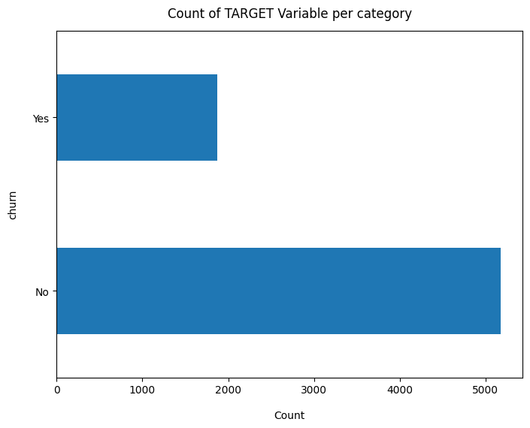
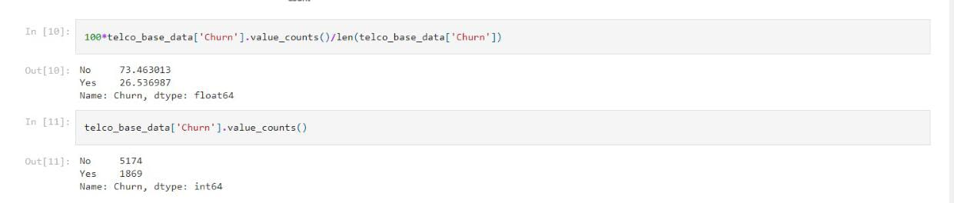
Churn Ratio
Data is highly imbalanced, ratio = 73:27
So we analyse the data with other features while taking the target values separately to get some insights.

Slide 8
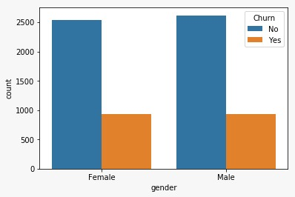
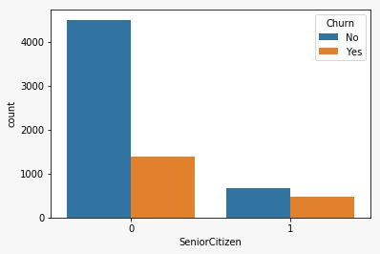
Here we can see that most of our customers are younger person
Churn percentage ratio of SeniorCitizen is more compared to there total rario.
Plot shows the gender distribution from the given data here almost male and female are in the ratio of 50:50 in both churn and non churned customers

Slide 9
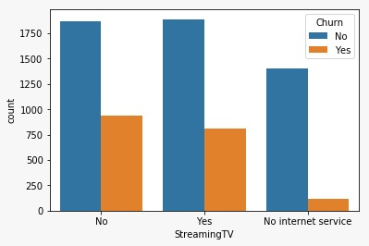
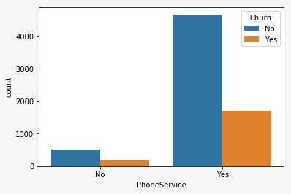
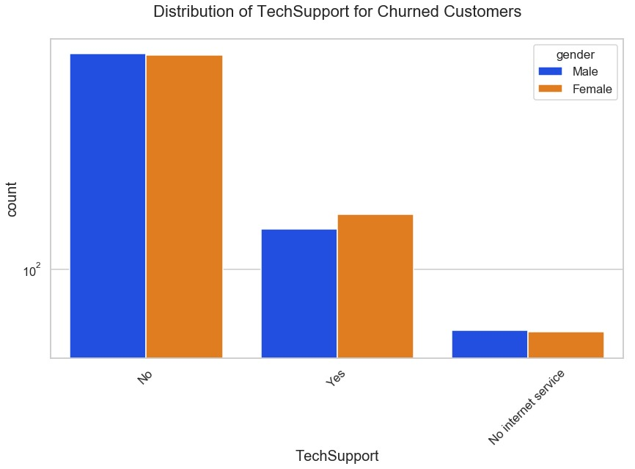

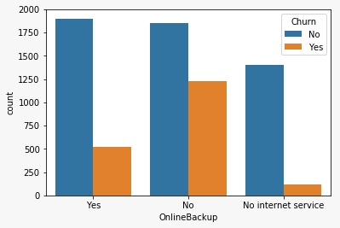
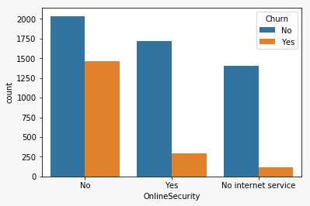
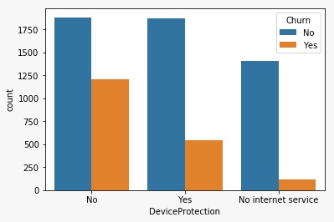
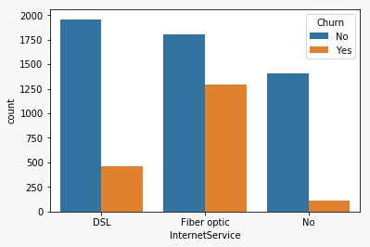
Services

Slide 10
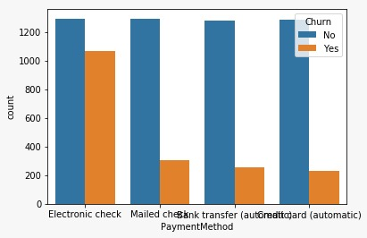
Payment Method

Slide 11
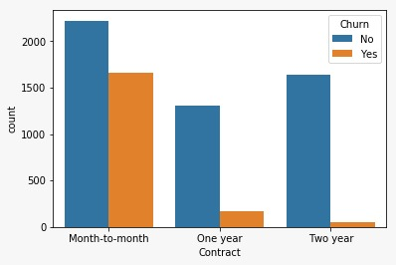
Contract

Slide 12
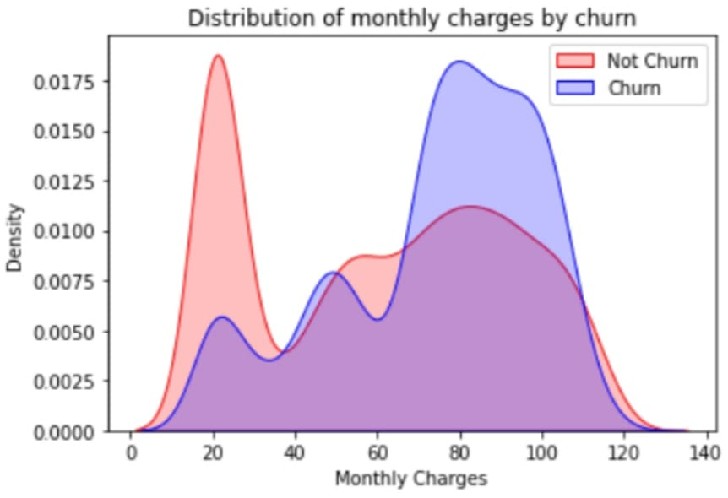
CHURN BY MONTHLY CHARGES
Higher % of customers churn when the monthly charges are high

Slide 13
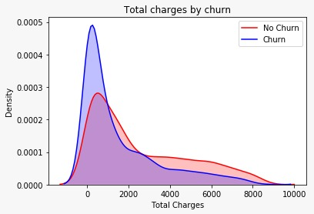
CHURN BY TOTAL CHARGES
High churn at low total churn

Slide 14
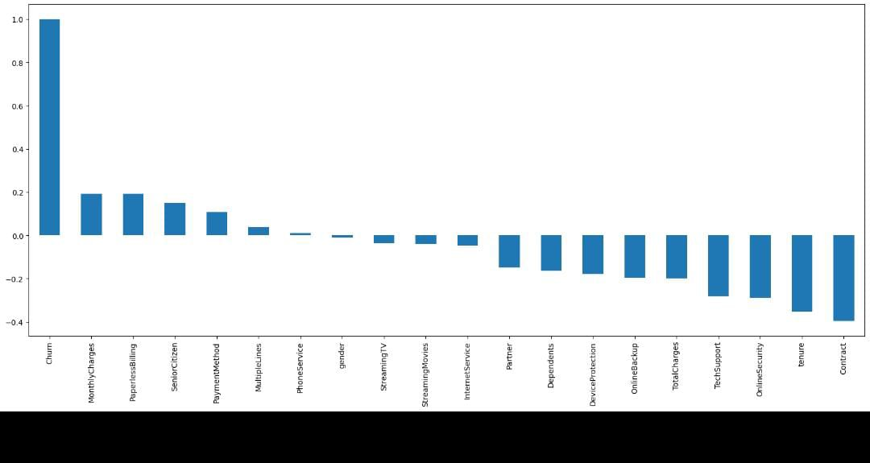
Correlation of all predictors with 'Churn'
HIGH Churn seen in case of Month to month contracts, No online security, No Tech support, First year of subscription and Fibre Optics Internet
LOW Churn is seens in case of Long term contracts, Subscriptions without internet service and The customers engaged for 5+ years
Factors like Gender, Availability of PhoneService and # of multiple lines have alomost NO impact on Churn

Slide 15
ACCURACY OF VARIOUS MODELS
MODELS | ACCURACY
DECISIONTREE CLASSIFIER | 76%
RANDOMFOREST CLASSIFIER | 77%

Slide 16
Synthetic Minority Oversampling Technique (SMOTE)
As we can see that the accuracy is quite low, and as it's an imbalanced dataset, we shouldn't consider Accuracy as our metrics to measure the model, as Accuracy is cursed in imbalanced datasets.
Hence, we are moving ahead to call SMOTEENN
MODELS | ACCURACY
DECISIONTREE CLASSIFIER | 89%
RANDOMFOREST CLASSIFIER | 90%

Slide 17
METRICS EVALUATION
CONFUSION MATRIX :
525 | 70
65 | 645
ACCURACY : 89.65%
PRECISSION : 89 %

Slide 18
FINDINGS AND SUGGESTIONS
Try to offer the better service for the churn customers, see how much this impact before and later. Some may use your service better move them to your active customers.
Take the feedback and suggestions within period of time and improve it, strive for better communication.
When you are taking any change in your plans of your business just predict the positive and negative share of that plan. If it is negative prepare the solution before, so you can handle easily.

Slide 19
HOW TO REDUCE CUSTOMER CHURN
Lean into your best customers
Be proactive with communication
Define a roadmap for your new customers
Offer incentives
Ask for feedback often
Analyze churn when it happens
Stay competitive

Slide 20
CONCLUSION
The importance of this type of research in the telecom market is to help companies make more profit.
It has become known that predicting churn is one of the most important sources of income to Telecom companies.
Hence, this research aimed to build a system that predicts the churn of customers in telecom company.
These prediction models need to achieve high AUC values. To test and train the model. The sample data is divided into 70% for the training and 30% for testing.

